Slide 1
NFT Trading Records Analysis

Slide 2
Content
Analysis Method
Fund Transfer
Trading Record
Marketplace Contract
Analysis Tool
Result Understanding

Slide 3
Fund Transfer Analysis
Native Token: ETH
ERC20 Token: USDT, USDC, WETH...
Native Token | ERC20 Token
Defined by Blockchain | Defined by Smart Contract
Transfer by sending Ethereum transactions | Transfer by calling contract functions
Recorded in every transaction | Recorded in contract logs
Created when mining | Created according to the contract code

Slide 4
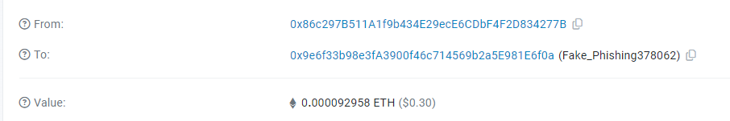
Example: ETH Transfer
Sender: 0x86c297B511A1f9b434E29ecE6CDbF4F2D834277B
Receiver: 0x9e6f33b98e3fA3900f46c714569b2a5E981E6f0a
Transfer: 0.000092958 ETH
Data can be found in transaction fields
Transaction Hash: 0x335f01c6ace6cc9e686c6a6a63c0fd95e7f29ba23ca3f12481e9a29953363236

Slide 5
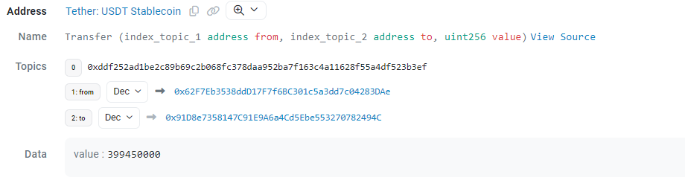
Example: ERC20 Transfer
Sender: 0x62F7Eb3538ddD17F7f6BC301c5a3dd7c04283DAe
Receiver: 0x91D8e7358147C91E9A6a4Cd5Ebe553270782494C
Transfer: 399.45 USDT
Data can be found in transaction log
Transaction Hash: 0x47e4e9ae3767a7d60203a0f64ef081b0d9fa366c03e9569fb9db5ca4ac9682ef

Slide 6
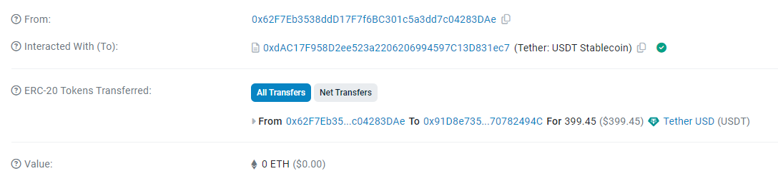
Transaction field:
To: the ERC20 token address
Value: 0 (otherwise ‘from’ address will send ETH to the contract address)

Slide 7
NFT Trading Record
NFT transfer record can be located similar to ERC20
But trading record can only be found in the marketplace contract

Slide 8


Smart Contract Analysis
Every NFT marketplace deploys one or several smart contracts on chain
These smart contracts perform the core trading logics (e.g. price matching, fund transfer, transaction fee, ...)
1. Call Buy function
Transfer ETH from buyer
Buyer
2. Contract activate fund transfer (according to contract code)
Transfer NFT from seller
Emit Buy event
function Buy
Buy Log (Buyer, Seller, price)
Seller
Marketplace contract

Slide 9
Trading data is located in:
1. Event Log
Every trading record has a coresponding event log
Data field defined by the marketplace contracts
Some data needed may be missing as the contract does not include them
All event logs are visible
2. Function input
Should contain every piece of information to initiate a trade
Some data may need to refer to the contract’s member variable
Function input may be invisible because of recursive call
Both method need a certain degree of inference according to the contract logic to extract relevant data

Slide 10
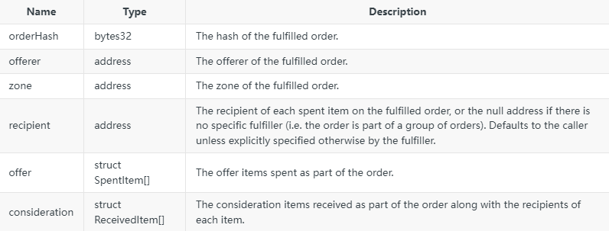
Example: Opensea Seaport
Key event: Orderfulfilled
‘offerer’ spends the items in ‘offer’ to recipient in return of ‘consideration’

Slide 11
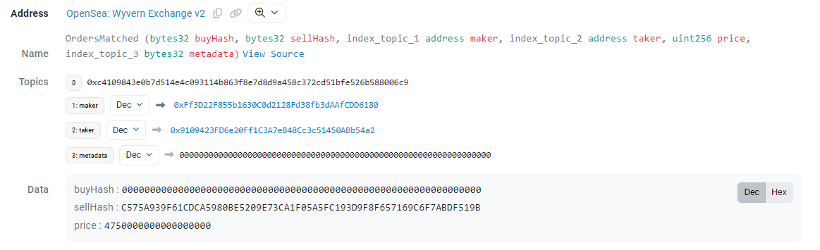
Example: Opensea Wyvern Protocol
Only one event emitted from the market place contract
No NFT data inside
Solution: Input data / NFT transfer log
Transaction Hash: 0x474ae3af949afc3304d885458c3da83e1ce63bbafd4559531a464713e4c87a42

Slide 12
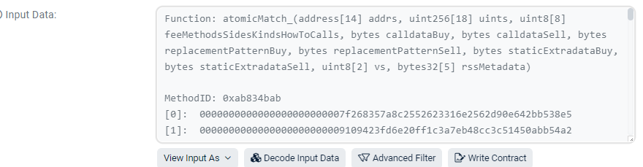
Input data example
Why not referring to NFT log
Because log can be complicated when the function is called internally by another contract
NFT data

